Slide 1




HackOrbit 2025
TEAM NAME
Stack Hackers

Slide 2

THEME & PROBLEM STATEMENT
Web3 and Blockchain
Low voter turnout, electrical fraud , and restricted accessibility for citizens living far away or abroad are just a few of the serious issues facing the Indian Electoral System.
Current Systems frequently struggle to guarantee universal voter participation , are resource-intensive and lack transparency.
A Voting System that preserves the integrity of democratic processes and is safe , open and easy to use is becoming more and more necessary.

Slide 3
PROPOSED SOLUTION
A Blockchain-based digital voting platform that makes eklections safe, clear, and impossible to hack.
Using Web3 technologies , voters can vote from anywhere and verify their identities online.
Smart contracts make sure that every vote is recorded forever.
This decentralized method increases voter trust in the electoral process.
It also makes sure that votes are counted correctly , removes duplicates , and makes it easier for voters who live far away or Non-Resident Indians to vote.

Slide 4
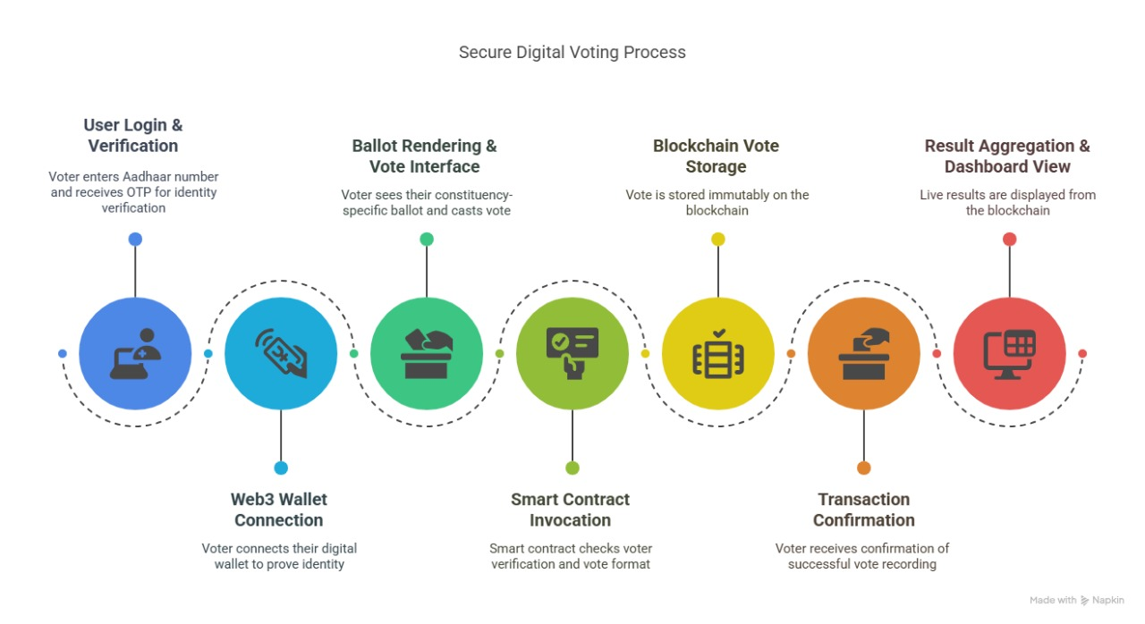
FLOWCHART / DIAGRAM

Slide 5
FLOWCHART / DIAGRAM
Voters use their OTP (One Time Password) and Aadhaar to log in.
Enables secure identity by connecting to the MetaMask wallet.
The list of candidates is displayed based on the Constituency.
Voters cast Ballots , which are managed by smart contracts. Votes are permanently recorded on the Polygon Blockchain. The Voter receives a confirmation. Activity is tracked by the Admin Panel .
IPFS(InterPlanetary File System) stores data related to public elections.

Slide 6
jjjk
FEATURES AND NOVELTY
Voting from anywhere , so you don’t have to go to a polling place.
Each person is guaranteed one vote thanks to Blockchain technology and smart contract logic.
Vote records are considered final once they are submitted.
No more intermediaries – No manual vote counting or storage.
Supports Migrant and NRI voters who are currently prohibited from casting their votes. Tracking of final results that are visible to all but hidden to each voter.

Slide 7
TECH STACK
Frontend - React.js
Authentication - Aadhaar OTP(Mock API)
Web3 Integration - MetaMask + Web3.js
Smart Contracts - Solidity
Blockchain Network - Polygon Blockchain
Vote Storage - On-Chain (Immutable Ledger)
Result Dashboard - React.js + Web3.js
Backend - Node.js + Express.js
Storage - IPFS

Slide 8
DRAWBACK AND
SHOWSTOPPERS
People who live in rural areas and older people don’t know much about technology. In some places that are far away , internet access is not always available. There is no law that lets people vote online or through Blockchain. Problems with checking Voters’ identities safely on a large scale. People don’t trust digital voting systems. Threats to user interface security , like phishing and wallet hacks.

Slide 9
TEAM MEMBERS DETAILS
Team Member 1
Name : KAMALARANI M
Phone No. : +91 9952202551
College : THIAGARAJAR COLLEGE OF ENGINEERING , MADURAI
Email id : kamalarani@student.tce.edu
Team Member 2
Name : HARINI MAI V G
Phone No. : +91 9360320107
College : THIAGARAJAR COLLEGE OF ENGINEERING , MADURAI
Email id : harinimai@student.tce.edu
Team Member 3
Name : ROSHINI K
Phone No. : +91 9791288203
College : THIAGARAJAR COLLEGE OF ENGINEERING , MADURAI
Email id : roshinik@student.tce.edu

Slide 10
Thank you

